Slide 1


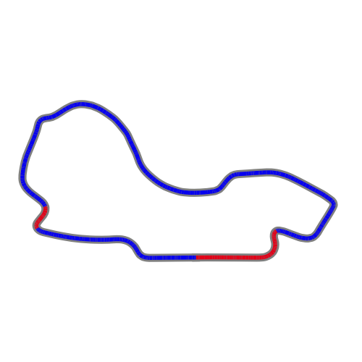
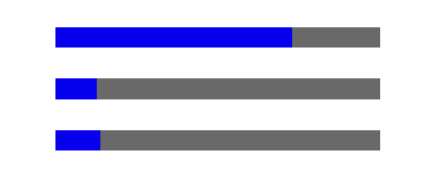

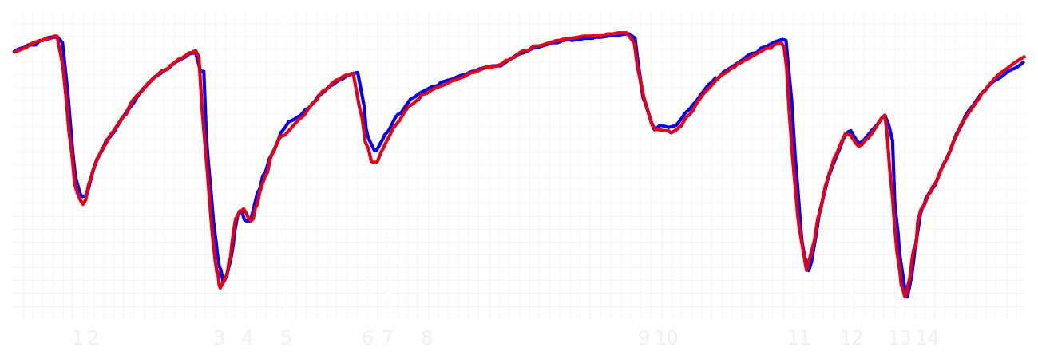
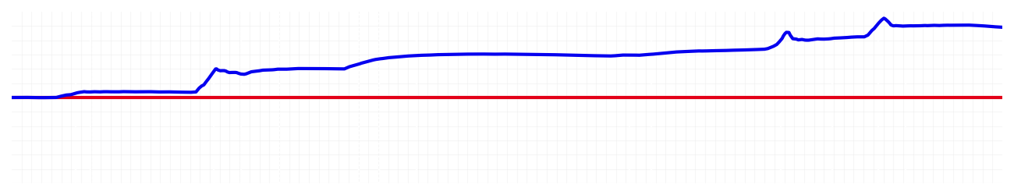
Australian GP Qualifying Q1
Max Verstappen
Driver
Liam Lawson
Driver
Lap Time
01:16.018
01:17.094
Lap Time
Sector 1
26.366
Speed Trap 1
291 kp/h
Speed Trap 1
291 kp/h
Sector 1
26.819
Sector 2
17.171
Speed Trap 2
327 kp/h
Gap
-1.076
Gap
1.076
Speed Trap 2
329 kp/h
Sector 2
17.362
Sector 3
32.481
Speed Final Line
303 kp/h
Corner Advantage
3/15
Corner Advantage
12/15
Speed Final Line
307 kp/h
Sector 3
32.913
FULL THROTTLE
73%
72%
FULL THROTTLE
HEAVY BREAKING
13%
12%
HEAVY BREAKING
%LAP TIME
CORNERING
14%
16%
CORNERING
%LAP TIME
SPEED
SPEED
DELTA TIME
DELTA TIME

Slide 2

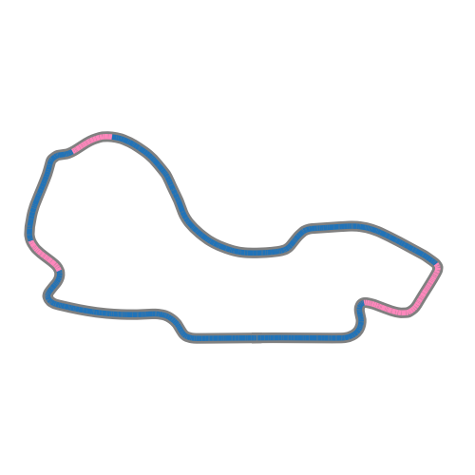
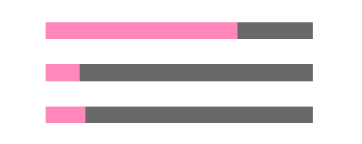
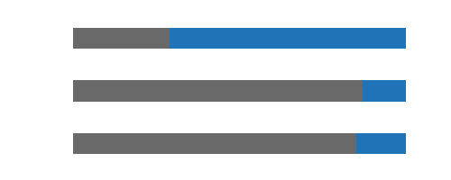
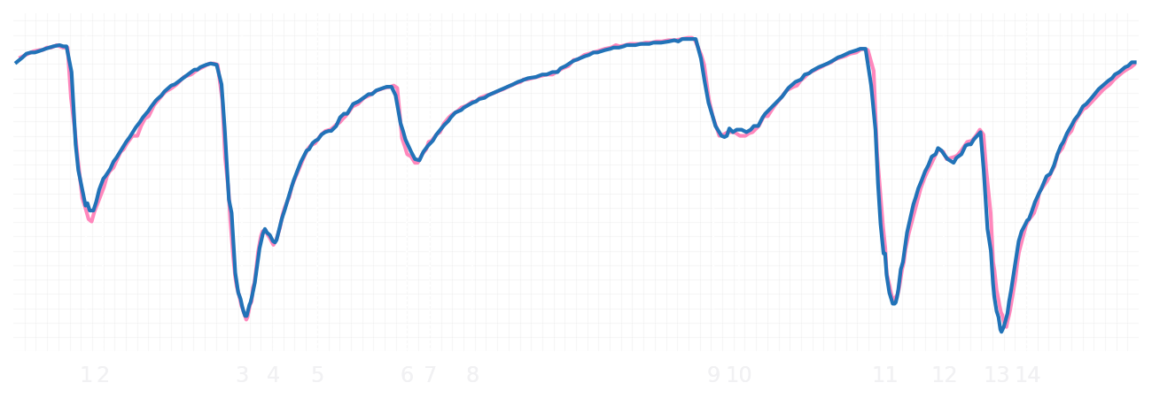
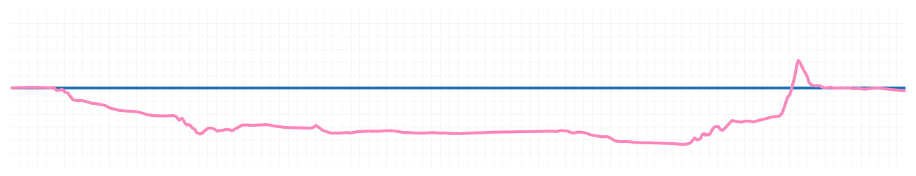
Australian GP Qualifying Q1
Pierre Gasly
Driver
Jack Doohan
Driver
Lap Time
01:16.328
01:16.315
Lap Time
Sector 1
26.540
Speed Trap 1
288 kp/h
Speed Trap 1
289 kp/h
Sector 1
26.381
Sector 2
17.148
Speed Trap 2
328 kp/h
Gap
0.013
Gap
-0.013
Speed Trap 2
326 kp/h
Sector 2
17.150
Sector 3
32.640
Speed Final Line
308 kp/h
Corner Advantage
11/15
Corner Advantage
4/15
Speed Final Line
309 kp/h
Sector 3
32.784
FULL THROTTLE
72%
71%
FULL THROTTLE
HEAVY BREAKING
13%
13%
HEAVY BREAKING
%LAP TIME
CORNERING
15%
16%
CORNERING
%LAP TIME
SPEED
SPEED
DELTA TIME
DELTA TIME

Slide 3

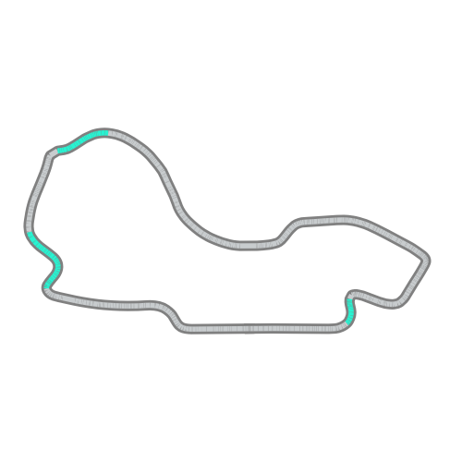
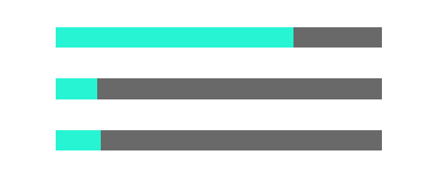
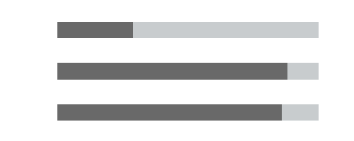
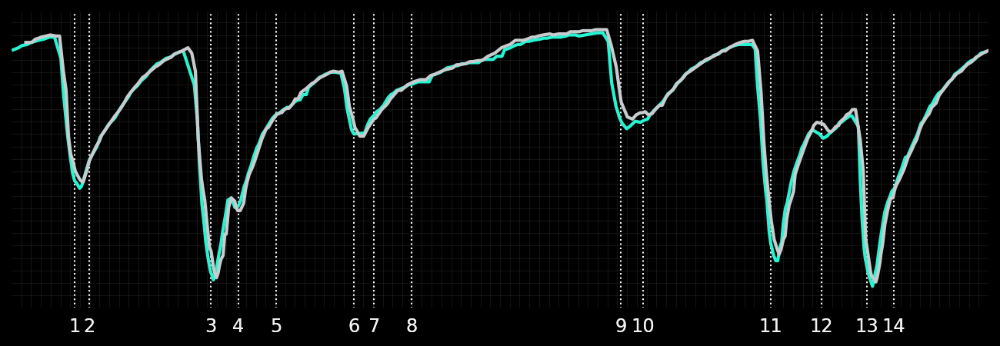
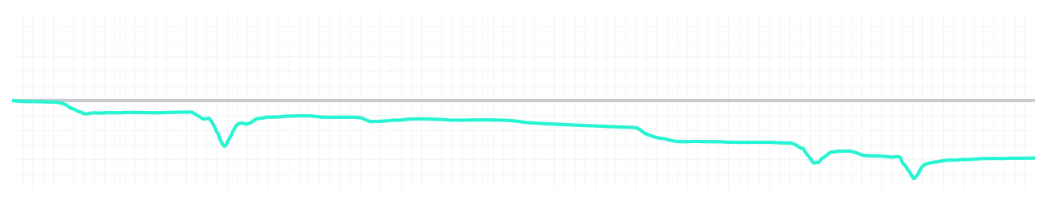
Australian GP Qualifying Q1
Kimi Antonelli
Driver
George Russell
Driver
Lap Time
01:16.525
01:15.971
Lap Time
Sector 1
26.443
Speed Trap 1
290 kp/h
Speed Trap 1
291 kp/h
Sector 1
26.366
Sector 2
17.166
Speed Trap 2
325 kp/h
Gap
0.554
Gap
-0.554
Speed Trap 2
328 kp/h
Sector 2
17.086
Sector 3
32.916
Speed Final Line
309 kp/h
Corner Advantage
9/15
Corner Advantage
6/15
Speed Final Line
310 kp/h
Sector 3
32.519
FULL THROTTLE
73%
71%
FULL THROTTLE
HEAVY BREAKING
13%
12%
HEAVY BREAKING
%LAP TIME
CORNERING
14%
17%
CORNERING
%LAP TIME
SPEED
SPEED
DELTA TIME
DELTA TIME

Slide 4

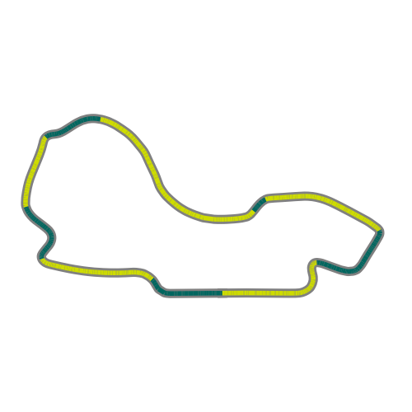
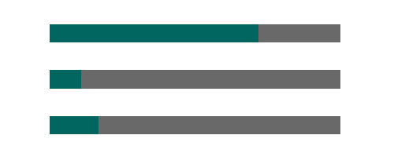

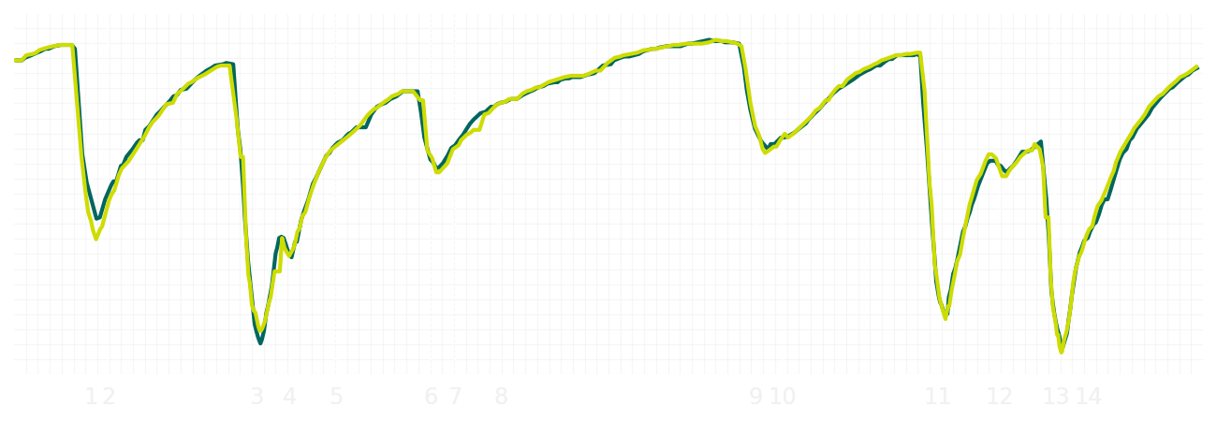
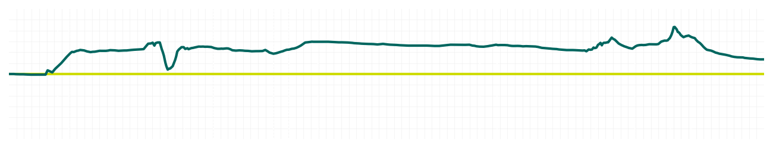
Australian GP Qualifying Q1
Fernando Alonso
Driver
Lance Stroll
Driver
Lap Time
01:16.288
01:16.369
Lap Time
Sector 1
26.300
Speed Trap 1
289 kp/h
Speed Trap 1
290 kp/h
Sector 1
26.474
Sector 2
17.107
Speed Trap 2
327 kp/h
Gap
-0.081
Gap
0.081
Speed Trap 2
328 kp/h
Sector 2
17.151
Sector 3
32.881
Speed Final Line
308 kp/h
Corner Advantage
6/15
Corner Advantage
9/15
Speed Final Line
309 kp/h
Sector 3
32.744
FULL THROTTLE
72%
72%
FULL THROTTLE
HEAVY BREAKING
11%
13%
HEAVY BREAKING
%LAP TIME
CORNERING
17%
15%
CORNERING
%LAP TIME
SPEED
SPEED
DELTA TIME
DELTA TIME

Slide 5

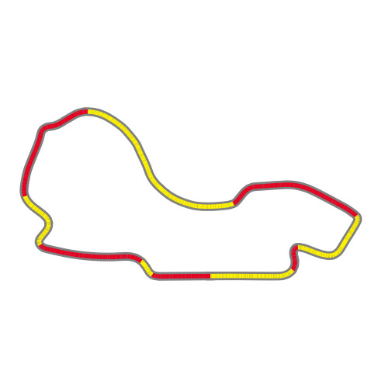
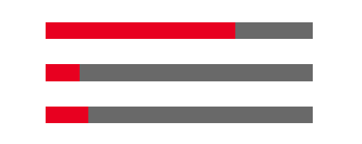
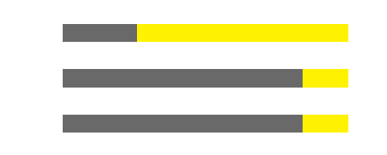
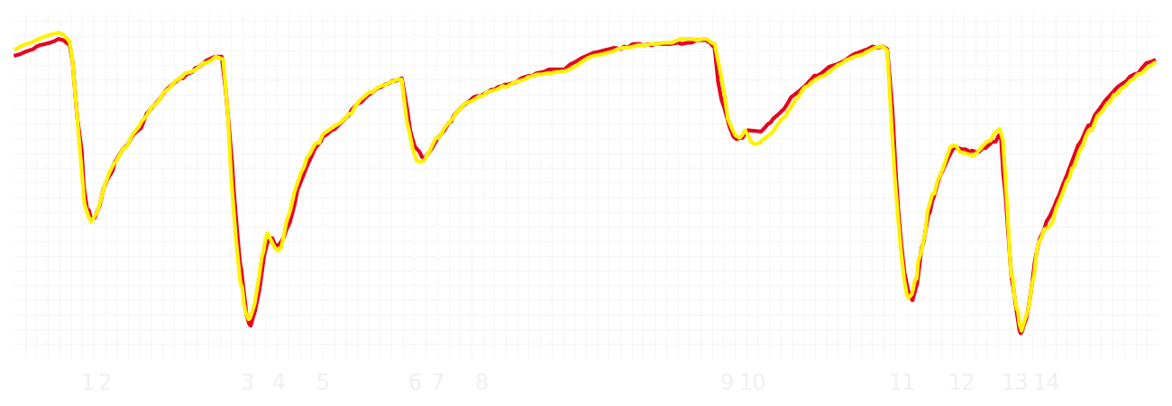
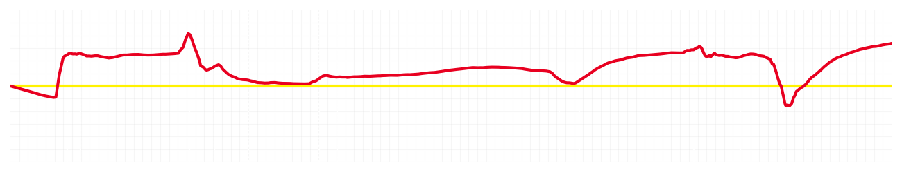
Australian GP Qualifying Q1
Charles Leclerc
Driver
Lewis Hamilton
Driver
Lap Time
01:16.029
01:16.213
Lap Time
Sector 1
26.411
Speed Trap 1
290 kp/h
Speed Trap 1
290 kp/h
Sector 1
26.347
Sector 2
17.144
Speed Trap 2
322 kp/h
Gap
-0.184
Gap
0.184
Speed Trap 2
323 kp/h
Sector 2
17.224
Sector 3
32.474
Speed Final Line
308 kp/h
Corner Advantage
6/15
Corner Advantage
9/15
Speed Final Line
305 kp/h
Sector 3
32.642
FULL THROTTLE
71%
74%
FULL THROTTLE
HEAVY BREAKING
13%
16%
HEAVY BREAKING
%LAP TIME
CORNERING
16%
10%
CORNERING
%LAP TIME
SPEED
SPEED
DELTA TIME
DELTA TIME

Slide 6

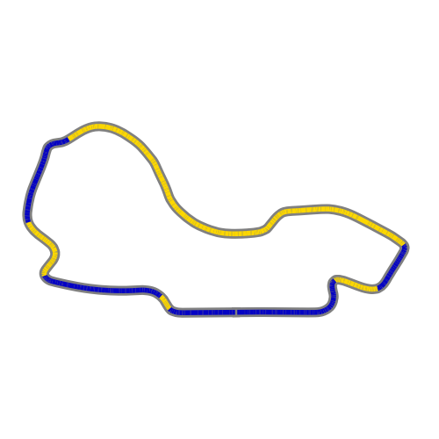
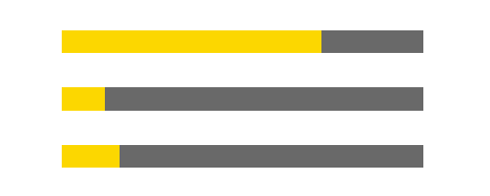
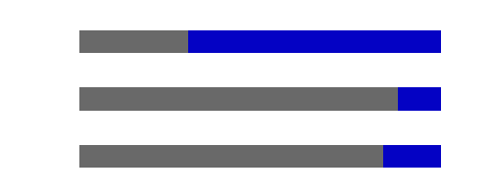
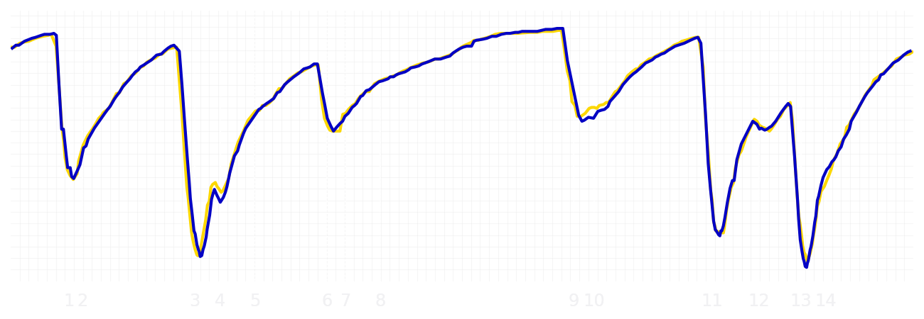
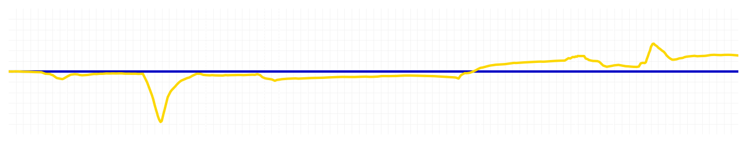
Australian GP Qualifying Q1
Yuki Tsunoda
Driver
Isack Hadjar
Driver
Lap Time
01:16.225
01:16.354
Lap Time
Sector 1
26.468
Speed Trap 1
291 kp/h
Speed Trap 1
292 kp/h
Sector 1
26.523
Sector 2
17.173
Speed Trap 2
328 kp/h
Gap
-0.129
Gap
0.129
Speed Trap 2
329 kp/h
Sector 2
17.139
Sector 3
32.584
Speed Final Line
307 kp/h
Corner Advantage
6/15
Corner Advantage
9/15
Speed Final Line
308 kp/h
Sector 3
32.692
FULL THROTTLE
72%
70%
FULL THROTTLE
HEAVY BREAKING
12%
12%
HEAVY BREAKING
%LAP TIME
CORNERING
16%
18%
CORNERING
%LAP TIME
SPEED
SPEED
DELTA TIME
DELTA TIME

Slide 7

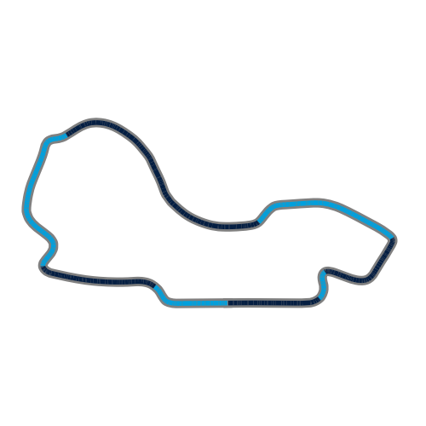
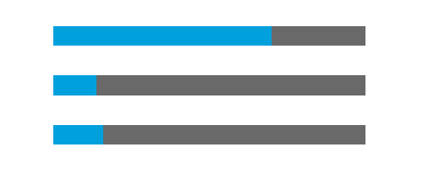

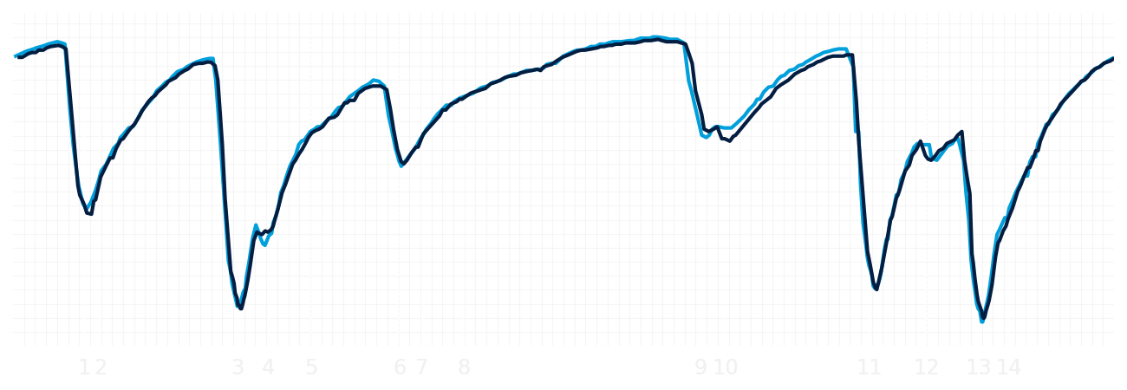
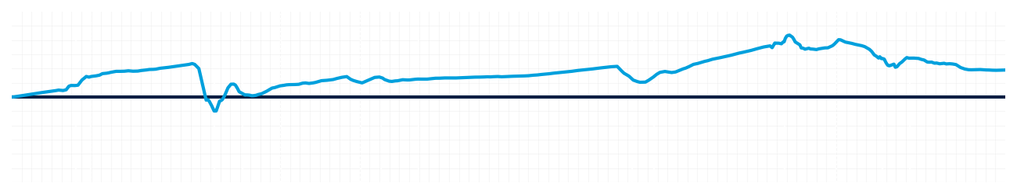
Australian GP Qualifying Q1
Alexander Albon
Driver
Carlos Sainz
Driver
Lap Time
01:16.245
01:16.360
Lap Time
Sector 1
26.378
Speed Trap 1
292 kp/h
Speed Trap 1
289 kp/h
Sector 1
26.477
Sector 2
17.153
Speed Trap 2
327 kp/h
Gap
-0.115
Gap
0.115
Speed Trap 2
325 kp/h
Sector 2
17.175
Sector 3
32.714
Speed Final Line
309 kp/h
Corner Advantage
6/15
Corner Advantage
9/15
Speed Final Line
310 kp/h
Sector 3
32.708
FULL THROTTLE
70%
71%
FULL THROTTLE
HEAVY BREAKING
14%
14%
HEAVY BREAKING
%LAP TIME
CORNERING
16%
15%
CORNERING
%LAP TIME
SPEED
SPEED
DELTA TIME
DELTA TIME

Slide 8

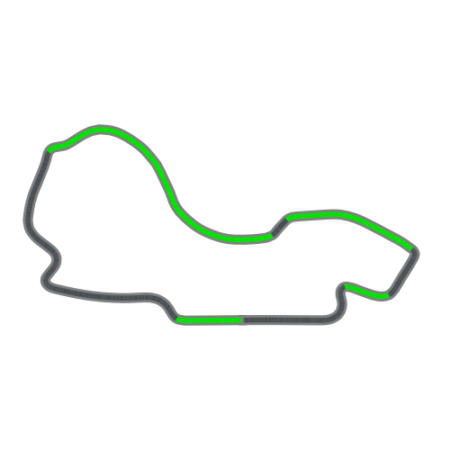
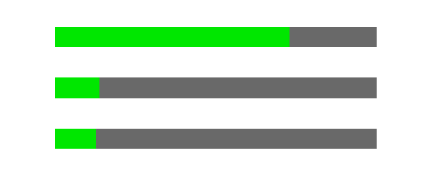
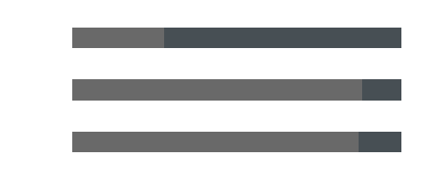
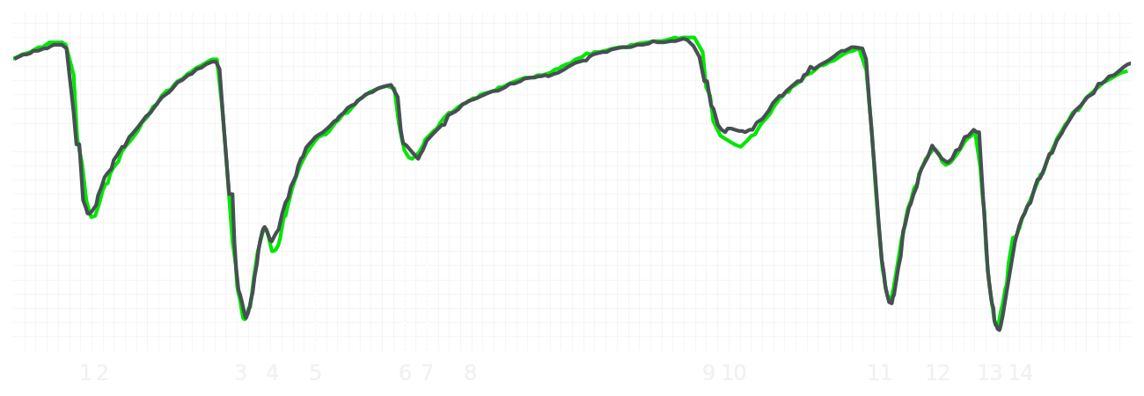
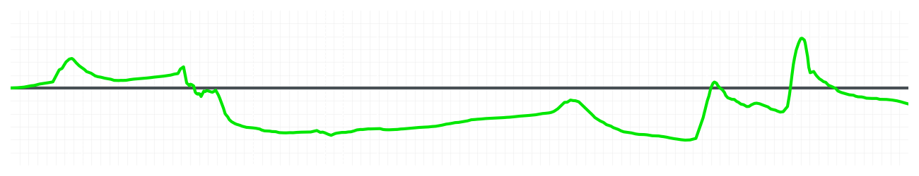
Australian GP Qualifying Q1
Nico Hulkenberg
Driver
Gabriel Bortoleto
Driver
Lap Time
01:16.579
01:16.516
Lap Time
Sector 1
26.656
Speed Trap 1
288 kp/h
Speed Trap 1
289 kp/h
Sector 1
26.495
Sector 2
17.201
Speed Trap 2
328 kp/h
Gap
0.063
Gap
-0.063
Speed Trap 2
327 kp/h
Sector 2
17.220
Sector 3
32.722
Speed Final Line
302 kp/h
Corner Advantage
9/15
Corner Advantage
6/15
Speed Final Line
306 kp/h
Sector 3
32.801
FULL THROTTLE
73%
72%
FULL THROTTLE
HEAVY BREAKING
14%
12%
HEAVY BREAKING
%LAP TIME
CORNERING
13%
16%
CORNERING
%LAP TIME
SPEED
SPEED
DELTA TIME
DELTA TIME

Slide 9

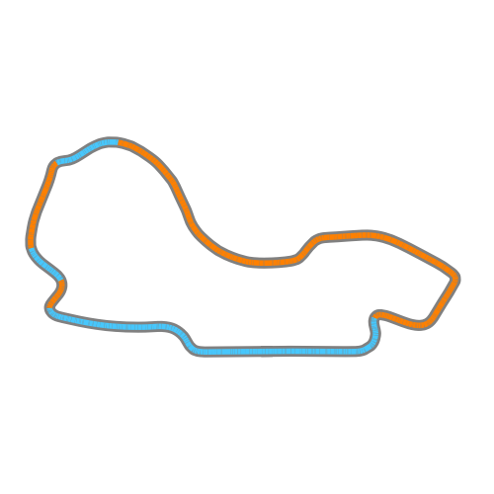

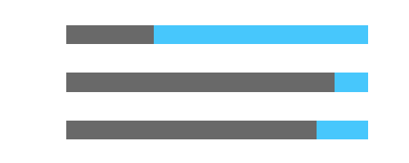
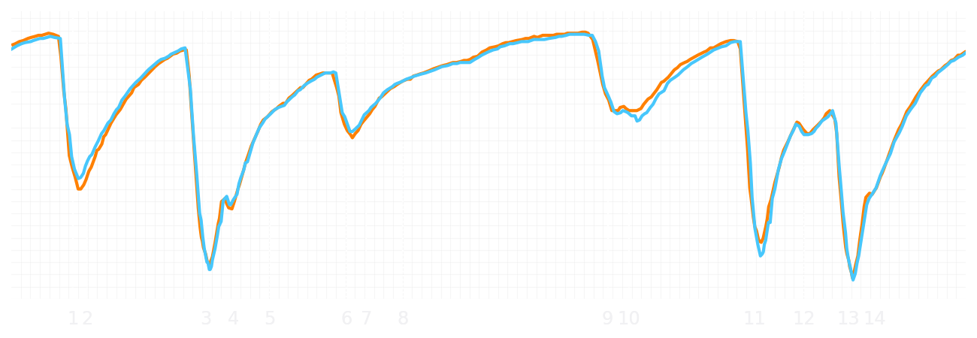
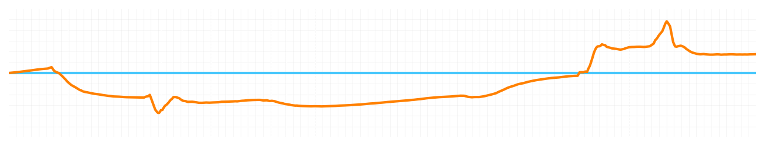
Australian GP Qualifying Q1
Lando Norris
Driver
Oscar Piastri
Driver
Lap Time
01:15.912
01:16.062
Lap Time
Sector 1
26.463
Speed Trap 1
290 kp/h
Speed Trap 1
289 kp/h
Sector 1
26.270
Sector 2
17.116
Speed Trap 2
326 kp/h
Gap
-0.15
Gap
0.15
Speed Trap 2
325 kp/h
Sector 2
17.114
Sector 3
32.333
Speed Final Line
308 kp/h
Corner Advantage
8/15
Corner Advantage
7/15
Speed Final Line
307 kp/h
Sector 3
32.678
FULL THROTTLE
71%
71%
FULL THROTTLE
HEAVY BREAKING
12%
11%
HEAVY BREAKING
%LAP TIME
CORNERING
17%
18%
CORNERING
%LAP TIME
SPEED
SPEED
DELTA TIME
DELTA TIME

